Slide 1
Trade and Environment Introduction

Slide 2
Trade and Environment
What is relationship between Trade and Environment?
How trade may affect environment?
How environment may affect trade?

Slide 3
International Trade
Why Nations Trade?

Slide 4
Resource Distribution
The factors of production are not evenly distributed throughout the world
Human capital is more skilled in nations with higher literacy rates
Physical capital is deeper in some nations
Better machinery
Infrastructure is better
Natural resources

Slide 5
Resource Distribution
The unequal distribution of resources encourages nations to specialize
……

Slide 6
Absolute and Comparative Advantage
Absolute advantage...when one nation can produce a good at a lower cost than another
Comparative advantage...the ability for a nation to produce at a lower opportunity cost
The nation with the lowest opportunity cost should specialize in that product
Known as the law of comparative advantage

Slide 7
International Trade
Since some countries may have a comparative advantage over others, it makes sense for them to trade

Slide 8
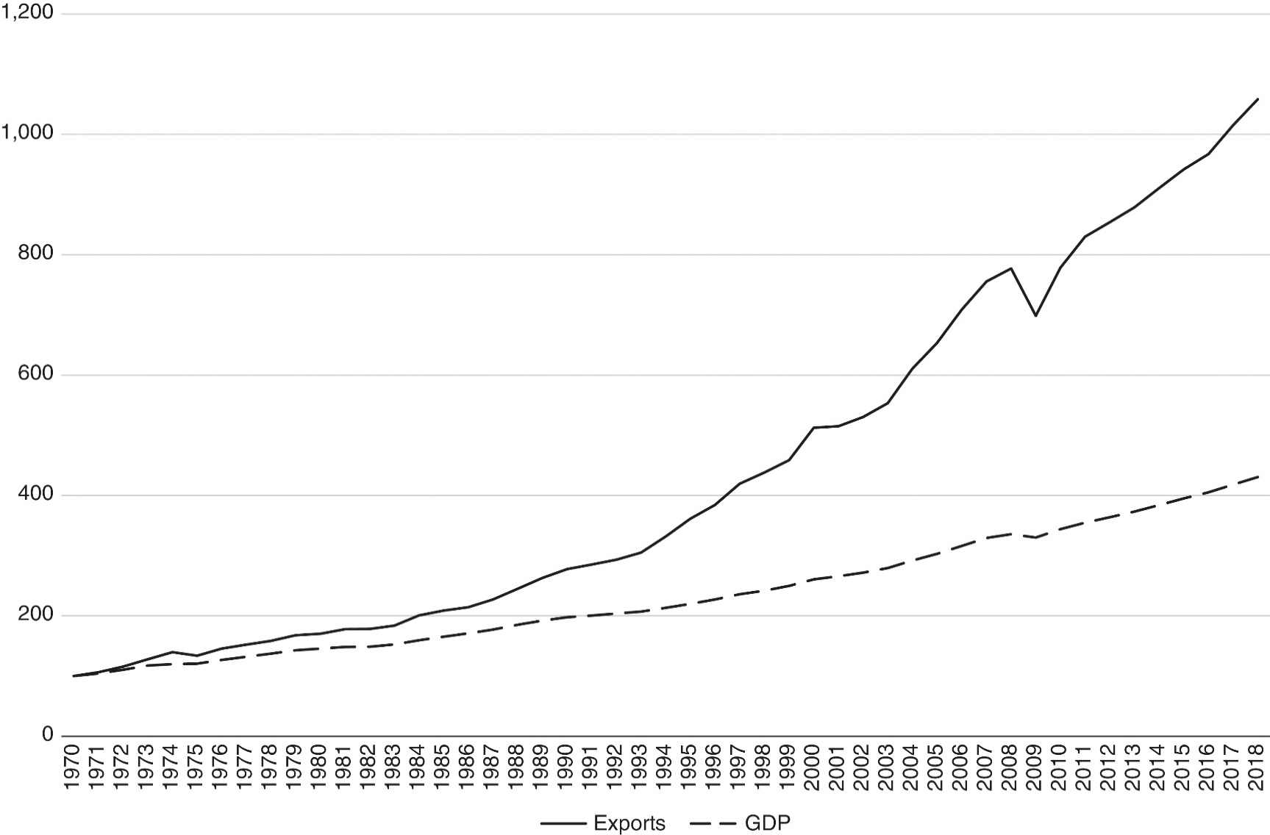
Gross Domestic Product and Exports in the World Economy, 1970 to 2018 (1970=100). Source: World Bank, World Development Indicators

Slide 10
Expansion of international trade
There are many reasons for the expansion of world trade:
Transportation: the container shipping revolution
Technology: information and communication technology (ICT)
Tariffs: trade liberalization
Entry of China: market reforms beginning in the late 1970s; joining the World Trade Organization (WTO) in 2001

Slide 11
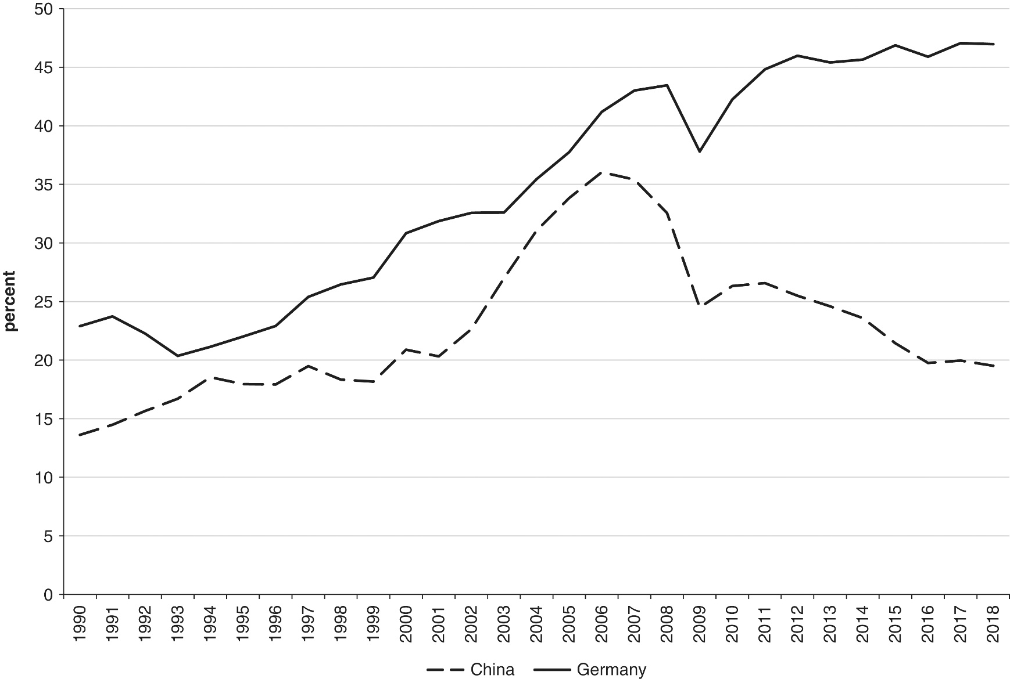
Figure 1.2 Exports as a percentage of GDP, China and Germany, 1990 to 2018. Source: World Bank, World Development Indicators
China’s exports as a percentage of GDP are substantially lower than those of Germany and
have been decreasing since 2006.

Slide 12
Gains from Trade
How could a country that is the most (least) efficient producer of everything gain from trade? •
Countries can specialize in production, while consuming many goods and services through trade.

Slide 13
Gains from Trade
– Gains from trade, explaining patterns of trade, effects of government policies on trade

Slide 14
Free Trade or Trade Barriers?
Many people argue that governments should regulate trade in order to protect industries and jobs from foreign competition
This is known as protectionism
Many nations set up trade barriers in order to provide protectionism

Slide 15
Free Trade or Trade Barriers?
Trade barriers...trade restrictions that prevent foreign products or services from freely entering a nation’s territory
Import quotas...limits on the amount that can be imported
Voluntary Export Restraints...self imposed export restraint

Slide 16
Impacts of Trade on Development
Different ways of defining development:
Mainstream economics: gross domestic product per capita (the average value of production produced by a citizen of a country)
Limitation: GDP is not a measure of welfare
Human Development Index (HDI), developed by the UNDP
Per capita income
Average life expectancy
Average levels of education
Development outcomes vary widely across countries

Slide 17
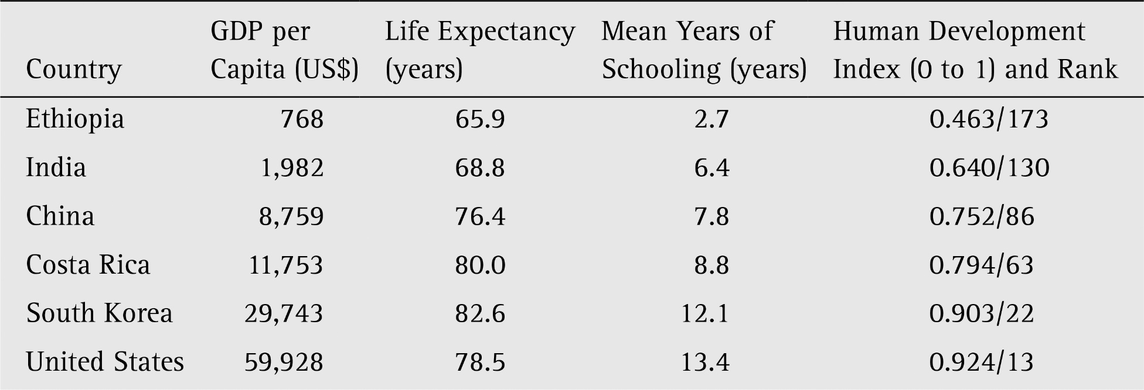
Table 1.1. Measures of Living Standards (2017). Sources: databank.worldbank.org; hdi.undp.org

Slide 18
Trade, Development and Environment : The Basic Issues
Environmental issues affect, and are affected by, economic development
Classic market failures lead to too much environmental degradation
Poverty and lack of education may also lead to non-sustainable use of environmental resources
Global warming and attendant climate change is a growing concern in developing countries

Slide 19
Trade, Development and Environment: The Basic Issues
Sustainable development has been defined as “meeting the needs of present generation without compromising the wellbeing of future generations”
So, running down the capital stock is not consistent with the idea of sustainability
In developing countries, environmental capital is generally a larger fraction of total capital
Environmental Degradation

Slide 21
Trade, Development and Environment : The Basic Issues
Environmental problems have consequences both for health and productivity
Loss of agricultural productivity
Prevalence of unsanitary conditions created by lack of clean water and sanitation
Dependence on biomass fuels and pollution
Airborne pollutants

Slide 22
Some impacts in Developing Countries identified by IPCC
increased severity of storms with heavy flooding and erosion
longer and more severe heat waves
reduced summer river flow and water shortages
decreased grain yields
climate-induced spreading ranges of pests and disease
lost and contaminated groundwater
deteriorated freshwater lakes, coastal fisheries, coastal flooding
prolonged droughts, expanded desertification
loss of essential species such as pollinators and soil organisms, forest and crop fires

Slide 23
Global Warming and Climate Change:
The benchmark 2007 IPCC report paints a dire picture for developing economies
Impact of global warming likely hardest on the poorest
Agriculture harmed in tropical and subtropical areas
Resultant conflicts over natural resources may grow
Range of adverse health impacts

Slide 24
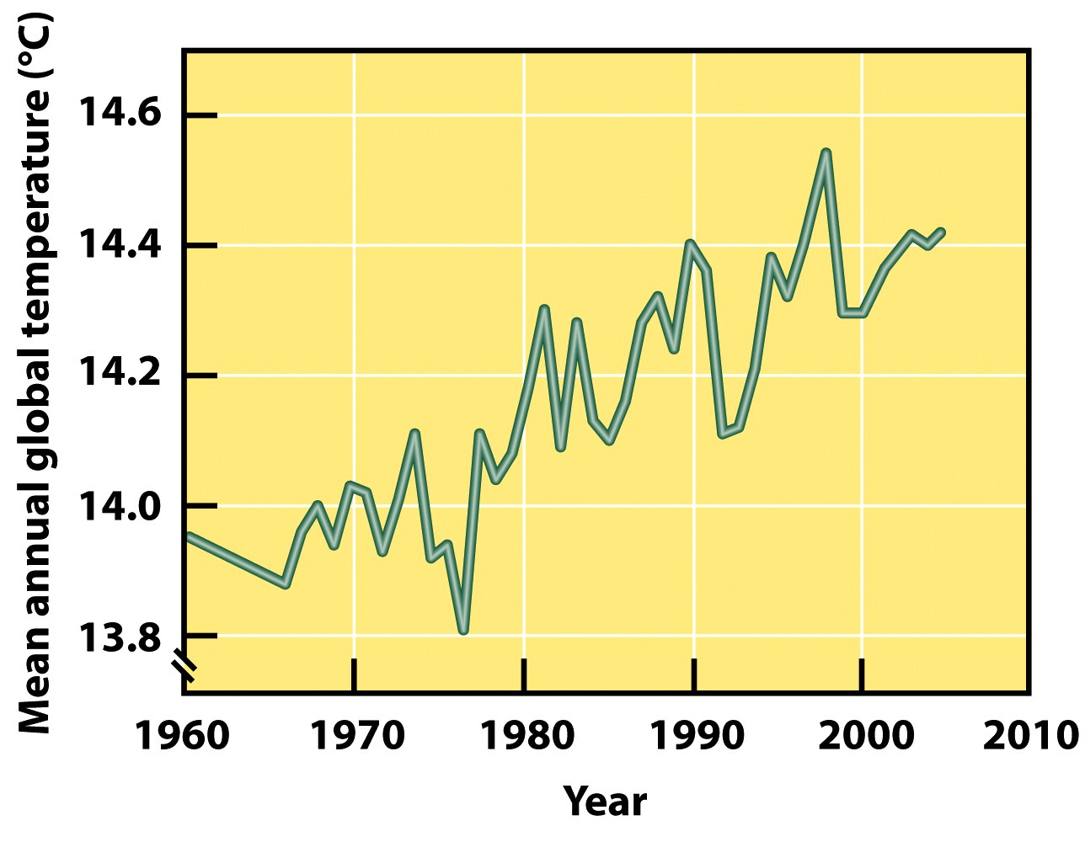
Climate Change- Mean Annual Global Temperature 1960-2005

Slide 25
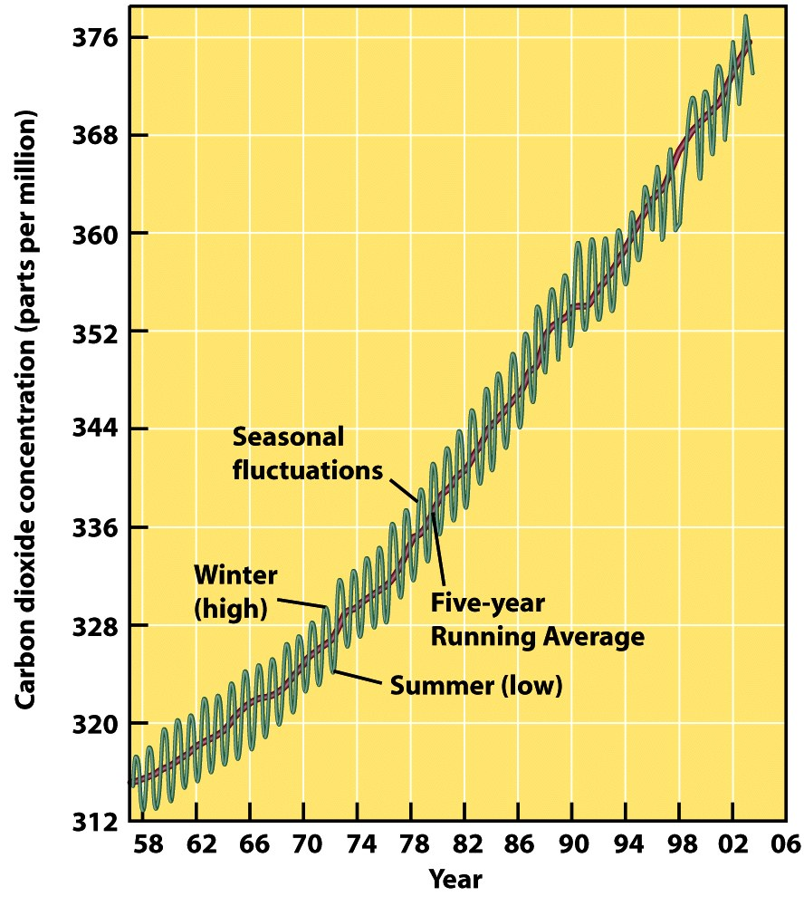
Causes
Increased concentration of CO₂ (right)
Burning fossil fuels in cars, industry and homes
Deforestation
Burning of forests

Slide 26
Policy Options
Proper resource pricing
Community involvement
Clearer property rights and resource ownership
Locate/invent alternative fuels to fossil fuels
Increase efficiency
Improved economic alternatives for the poor
Industrial emissions abatement policies
Proactive stance toward adapting to climate change

Slide 27
Policy Options
Lower developing country costs for environmental preservation
Trade policies: reduce barriers, subsidies

